Slide 1
Inheritance
Mohammad Salman
Dean’s Fellow

Slide 2
Logistics
Project plagiarisms are, unfortunately, quite common.
Some advice: please don’t plagiarize.
If you’re using AI or online resources, please cite your resources.
Understand what type of help is legitimate, and what help is not!
Don’t use a past project.

Slide 3
Warmup

Slide 4

What will be the output of this program?
Is Derived::getName() overriding Base::getName()?
class Base
{
public: virtual std::string getName() const { return "Base"; }
virtual ~Base() = default;
};
class Derived : public Base
{
public:
std::string getName() { return "Derived"; }
virtual ~Derived() = default;
};
int main()
{
Base* p { new Derived };
std::cout << p->getName();
delete p;
return 0;
}
Tells the compiler to provide a destructor.
I could have alternatively written though writing the derived’s dtor is optional.
virtual ~Base() {}
virtual ~Derived() {}
Notes:
Two parts –
- had I not written any dtor, compiler gives it to me. Writing default makes that explicit.
- because I’m working with inheritance, I want my base dtor to be virtual. Hence you see the virtual.

Slide 5

What will be the output of this program?
Is Derived::getName() overriding Base::getName()?
class Base
{
public: virtual std::string getName() const { return "Base"; }
virtual ~Base() = default;
};
class Derived : public Base
{
public:
std::string getName() const { return "Derived"; }
virtual ~Derived() = default;
};
int main()
{
Base* p { new Derived };
std::cout << p->getName();
delete p;
return 0;
}
As soon as the return type and signature get matched, Derived::getName() overrides Base::getName(). As such, writing both virtual and override are optional with Derived::getName().
However, writing override is recommended. Helps to avoid mistakes and improves readability. Also, override implies virtual, so only writing override is sufficient.

Slide 6
Pure Virtual Functions
Introduction to Abstract Base Classes and Interfaces.
https://www.learncpp.com/cpp-tutorial/pure-virtual-functions-abstract-base-classes-and-interface-classes/

Slide 7
Abstract Base Classes
Often times, when developing an inheritance hierarchy, you will find that instantiating objects of the most-base class won’t make sense.

Slide 8
In this situation, you probably would never create an object of class Robot, because it is too general, and the objects that you’ll want are probably more specific than this.
More general / abstract
class Robot
class GroundedRobot
class AirRobot
class TrackedWheels
class RegularWheels
class VTOL
class CTOL
Less general / abstract

Slide 9
Similar situation here too.
More general / abstract
class Employee
class Supervisor
class Engineer
class CookingStaff
class CleaningStaff
Less general / abstract

Slide 10
Abstract Base Classes
Enter pure virtual functions.
Such functions (usually) have no definitions (i.e. function bodies).
As such, these functions are meant to be defined by derived classes.
When we add a pure virtual function to our class, we are effectively saying, “it is up to the derived classes to implement this function”.
Notes:
“Usually” implies that they may have a body. This use case is uncommon though.

Slide 11
These are what pure virtual functions look like, and how they compare with other types of member functions.
Note that a function body isn’t required for pure virtual methods.
class Base
{
public:
std::string sayHi() const { return "Hi"; } // a normal non-virtual function
virtual std::string getName() const { return "Base"; } // a normal virtual function
virtual int getValue() const = 0 ; // a pure virtual function
int doSomething() = 0 ; // Compile error: can not set non-virtual functions to 0
};
Is something wrong here? Could I have made this class better?
If I have virtual methods, I intend on deriving more classes from class Base. Which means…
I should make Base::~Base() virtual!

Slide 12
Abstract Base Classes
There are two main consequences of introducing a pure virtual function.
Any class with at least one pure virtual function becomes an abstract base class, which means that it cannot be instantiated!
You cannot create objects of an abstract base class.
Any derived class should define a body for this function.
If not, then that derived class will also be considered an abstract base class.
So can’t create objects.

Slide 13
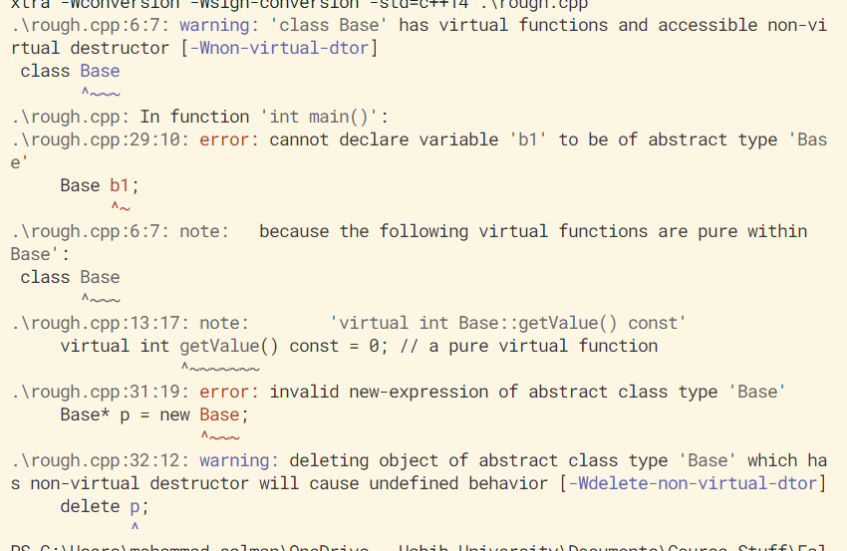
You can no longer instantiate objects of type Base.
class Base
{
public:
std::string sayHi() const { return "Hi"; }
virtual std::string getName() const { return "Base"; }
virtual int getValue() const = 0;
// int doSomething() = 0;
};
Again, Base::~Base() should be virtual here. By default, it isn’t virtual.
int main()
{
Base b1;
Base* p = new Base;
delete p;
return 0;
}
Notes:
Any problems here – delete p hasn’t been shown yet.

Slide 14
Because you didn’t define the pure virtual function in Derived, it is also considered abstract. Hence, you can’t instantiate objects of Derived as well.
class Base
{
public:
std::string sayHi() const { return "Hi"; }
virtual std::string getName() const { return "Base"; }
virtual int getValue() const = 0;
virtual ~Base() = default;
};
int main()
{ Derived d1;
Derived* p { new Derived };
delete p;
return 0;
}
class Derived : public Base
{
public:
std::string getName() const override { return "Derived"; }
virtual ~Derived() = default;
};
Overriding Base::getName(), however, is optional.

Slide 15
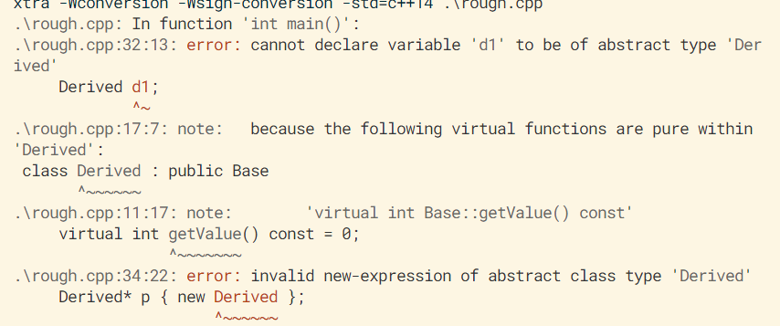
Because you didn’t define the pure virtual function in Derived, it is also considered abstract. Hence, you can’t instantiate objects of Derived as well.

Slide 16
An example to further motivate the advantage of having an Abstract Base Class.
Since you are forced to define pure virtual functions in derived classes, this provides an inherent benefit. Let’s see what that looks like.
class Cat: public Animal
{
public:
Cat(std::string name)
: Animal{ name }
{}
std::string speak() const override
{ return "Meow"; }
};
class Dog: public Animal
{
public:
Dog(std::string name)
: Animal{ name }
{}
std::string speak() const override
{ return "Woof"; }
};
class Animal
{
protected:
std::string m_name;
// Prevents us from making Animal objects in public.
// Derived classes can still use this.
Animal(std::string name)
: m_name{ name }
{}
public:
std::string getName() const
{ return m_name; }
virtual std::string speak() const
{ return "???"; }
virtual ~Animal() = default;
};

Slide 17
Animal::~Animal() is virtual.
Note that making ~Cat() and ~Dog() virtual improves readability. But isn’t required.
std::string Animal::speak() const is virtual, and is being overridden in Cat and Dog.
Animal::Animal() is protected – can’t make its objects in public.
Going off on a small tangent, could I have set it to private?
Nope, how will objects of Cat and Dog be constructed then.
class Cat: public Animal
{
public:
Cat(std::string name)
: Animal{ name }
{}
std::string speak() const override
{ return "Meow"; }
};
class Dog: public Animal
{
public:
Dog(std::string name)
: Animal{ name }
{}
std::string speak() const override
{ return "Woof"; }
};
class Animal
{
protected:
std::string m_name;
// Prevents us from making Animal objects in public.
// Derived classes can still use this.
Animal(std::string name)
: m_name{ name }
{}
public:
std::string getName() const
{ return m_name; }
virtual std::string speak() const
{ return "???"; }
virtual ~Animal() = default;
};

Slide 18
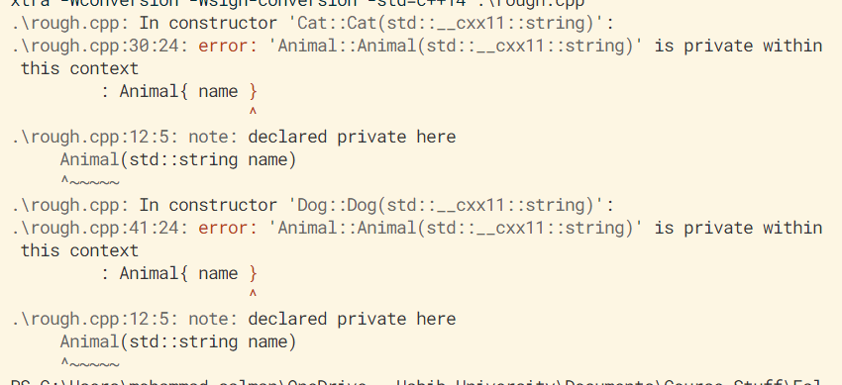
As an example, if Animal::Animal() is private, it can’t be called from within Cat::Cat() and Dog::Dog(). So the derived objects cannot be constructed.
class Cat: public Animal
{
public:
Cat(std::string name)
: Animal{ name }
{}
std::string speak() const override
{ return "Meow"; }
};
int main()
{
Cat cat1{ "tom" };
return 0;
}

Slide 19
Returning back to the main topic, what if I derive a new class from Animal, and forget to redefine speak()?
Let’s run through this program.
class Animal
{
protected:
std::string m_name;
Animal(std::string name)
: m_name{ name }
{}
public:
std::string getName() const
{ return m_name; }
virtual std::string speak() const
{ return "???"; }
virtual ~Animal() = default;
};
class Cow : public Animal
{
public:
Cow(std::string name)
: Animal{ name }
{}
// We forgot to redefine speak
};
Protected, so accessible.
int main()
{
Animal* pAni{ new Cow{"Betsy"} };
std::cout << pAni->getName() << " says "
<< pAni->speak() << '\n';
return 0;
}

Slide 20
Returning back to the main topic, what if I derive a new class from Animal, and forget to redefine speak()?
Let’s run through this program.
class Animal
{
protected:
std::string m_name;
Animal(std::string name)
: m_name{ name }
{}
public:
std::string getName() const
{ return m_name; }
virtual std::string speak() const
{ return "???"; }
virtual ~Animal() = default;
};
class Cow : public Animal
{
public:
Cow(std::string name)
: Animal{ name }
{}
// We forgot to redefine speak
};
Not virtual
int main()
{
Animal* pAni{ new Cow{"Betsy"} };
std::cout << pAni->getName() << " says "
<< pAni->speak() << '\n';
return 0;
}

Slide 21
Returning back to the main topic, what if I derive a new class from Animal, and forget to redefine speak()?
Let’s run through this program.
class Animal
{
protected:
std::string m_name;
Animal(std::string name)
: m_name{ name }
{}
public:
std::string getName() const
{ return m_name; }
virtual std::string speak() const
{ return "???"; }
virtual ~Animal() = default;
};
class Cow : public Animal
{
public:
Cow(std::string name)
: Animal{ name }
{}
// We forgot to redefine speak
};
int main()
{
Animal* pAni{ new Cow{"Betsy"} };
std::cout << pAni->getName() << " says "
<< pAni->speak() << '\n';
return 0;
}

Slide 22

Returning back to the main topic, what if I derive a new class from Animal, and forget to redefine speak()?
So now, what will be the output of this program?
class Animal
{
protected:
std::string m_name;
Animal(std::string name)
: m_name{ name }
{}
public:
std::string getName() const
{ return m_name; }
virtual std::string speak() const
{ return "???"; }
virtual ~Animal() = default;
};
class Cow : public Animal
{
public:
Cow(std::string name)
: Animal{ name }
{}
// We forgot to redefine speak
};
This is the most-derived implementation
int main()
{
Animal* pAni{ new Cow{"Betsy"} };
std::cout << pAni->getName() << " says "
<< pAni->speak() << '\n';
return 0;
}

Slide 23

If we make Animal::speak() pure virtual, we must define Cow::speak() so that its objects can be created.
We’re forced to define the function in Cow and cannot possibly forget.
Keeping Animal::Animal() protected is no longer a requirement – we can’t create Animal type objects because of pure virtual function.
class Animal
{
protected:
std::string m_name;
Animal(std::string name)
: m_name{ name }
{}
public:
std::string getName() const
{ return m_name; }
virtual std::string speak() const = 0;
// { return "???"; }
virtual ~Animal() = default;
};
class Cow : public Animal
{
public:
Cow(std::string name)
: Animal{ name }
{}
std::string speak() const override
{ return "Moo"; }
};
int main()
{
Animal* pAni{ new Cow{"Betsy"} };
std::cout << pAni->getName() << " says "
<< pAni->speak() << '\n';
return 0;
}

Slide 24
I hope you noticed an error in the last discussion…
Hint: C++ may not complain about this error.
Notes:
pAni wasn’t deleted.

Slide 25
Interfaces

Slide 26
Interface Classes
Have no member variables (i.e. attributes).
All member functions are pure virtual.
Interfaces tend to be very general as a consequence.
They’re easy to use and maintain.
Class names are conventionally prefixed with an ‘I’.
class IAnimal (assuming this was an interface).
An example on interfaces is discussed in the linked reading.
https://www.learncpp.com/cpp-tutorial/pure-virtual-functions-abstract-base-classes-and-interface-classes/
It is a brand new example.

Slide 27
Interface Classes
Interfaces will have virtual destructors just like we’ve seen before.
Note that even in an interface class, the destructor must have an implementation.
Some languages like Java and C# have a keyword, interface, for making interface classes.
So you don’t have to go and make every method pure virtual.
Within these other languages, interfaces allow for multiple inheritance.
For multiple inheritance in C++, interfaces are not required.

